Slide 1



数 据 通 信
Data Communication
刘衍珩
移动通信与网络系统
Mobile Communication & Network System
http://ccst.jlu.edu.cn/mcns

Slide 2



Chapter 2 Signals
Analog and digital
Periodic and non-periodic Signals
Frequency Spectrum of Periodic Signals
Frequency Spectrum of a non-periodic Signal
Signal Transmission Through a Frequency band-limited Channel

Slide 3
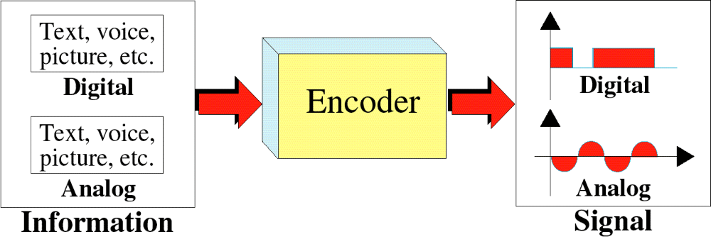
Analog and digital
Transformation of Information to Signals
To be transmitted, data must be transformed to electromagnetic signals.

Slide 4
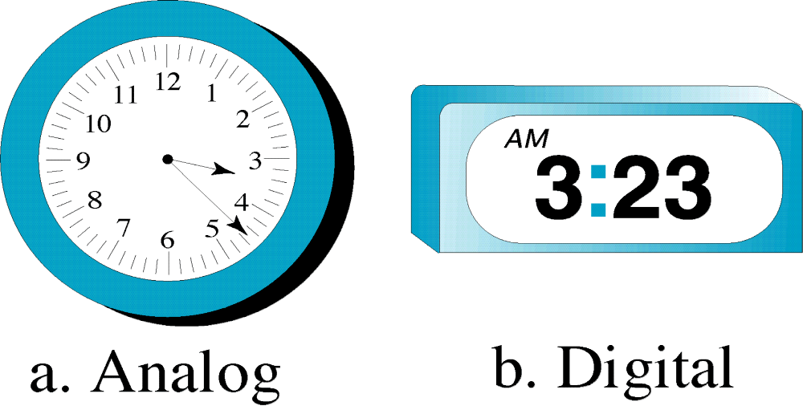
Analog and digital
Analog and Digital Clocks

Slide 5
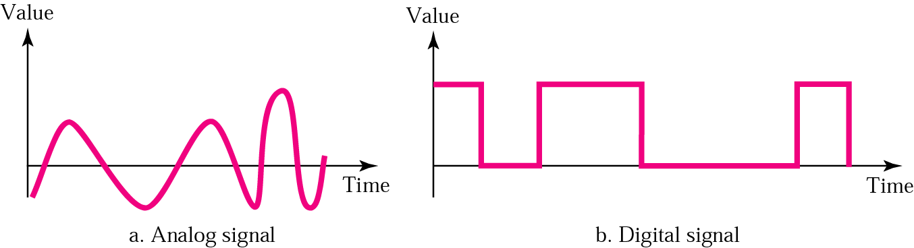
Analog and digital
Analog and Digital Signals

Slide 6
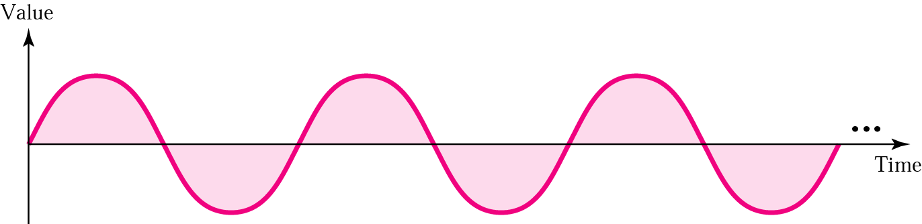
Analog and digital
Sine Wave (正弦波)
模拟信号可以被分为简单信号和复合信号。
  简单模拟信号或正弦波：不能被分解为更简单的模拟信号。
  复合信号：可以分解为多个正弦波。
正弦波的三个描述要素：
  振幅、周期或频率、相位

Slide 7
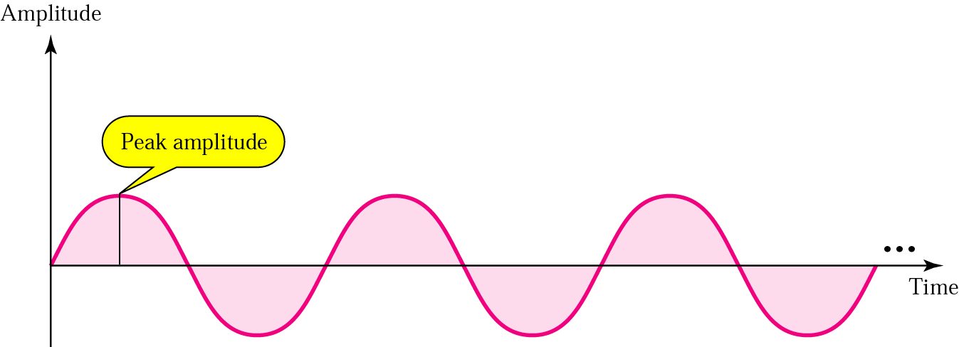
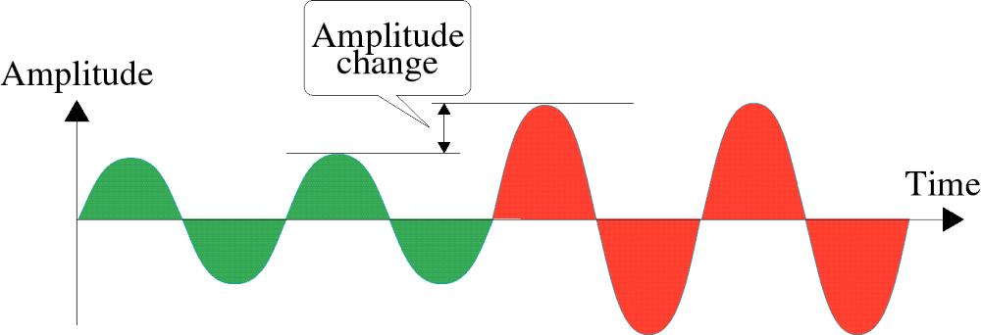
Analog and digital
Amplitude (振幅)
振幅：信号的高度，等于波上给定点到水平轴的垂直距离。
最大振幅：等于波形在垂直轴上所达到的最大值。
Amplitude Change

Slide 8
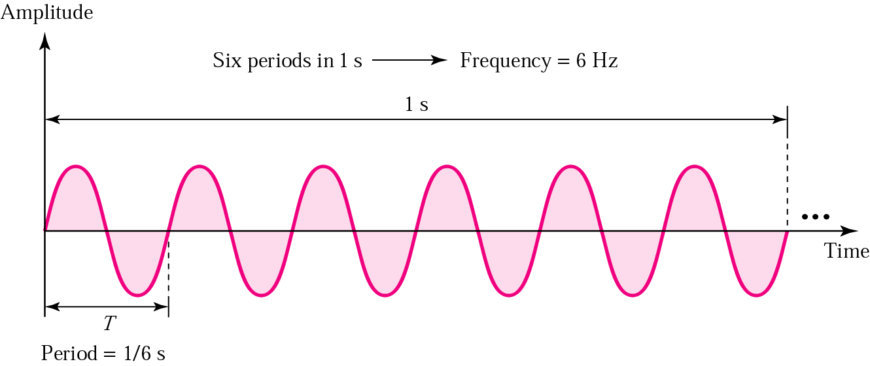
Analog and digital
Period and frequency
周期：信号完成一个波形循环所要经历的时间，以秒为单位。
频率：信号在一秒钟内完成的周期数，即每秒钟完成的循环次数。

Slide 9
Analog and digital
Period and frequency
Units of periods and frequencies
Unit | Equivalent | Unit | Equivalent
Seconds (s) | 1 s | hertz (Hz) | 1 Hz
Milliseconds (ms) | 10^{–3} s | kilohertz (KHz) | 10³ Hz
Microseconds (ms) | 10^{–6} s | megahertz (MHz) | 10⁶ Hz
Nanoseconds (ns) | 10^{–9} s | gigahertz (GHz) | 10⁹ Hz
Picoseconds (ps) | 10^{–12} s | terahertz (THz) | 10¹² Hz

Slide 10
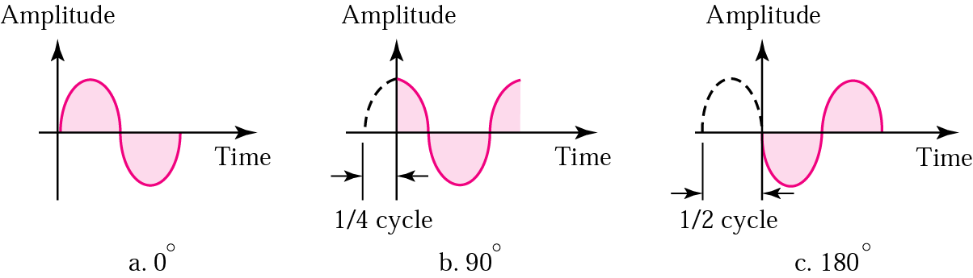
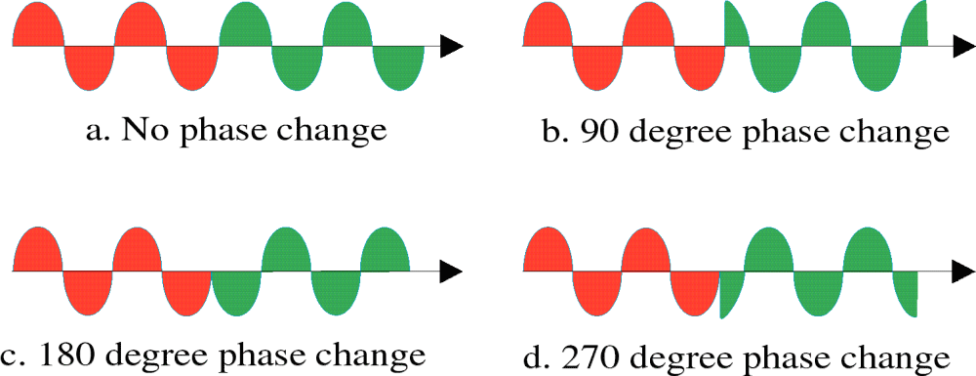
Analog and digital
Phase
相位：描述了波形中相对于时间零点的位置，以度或弧度为单位。
Phase Change

Slide 11
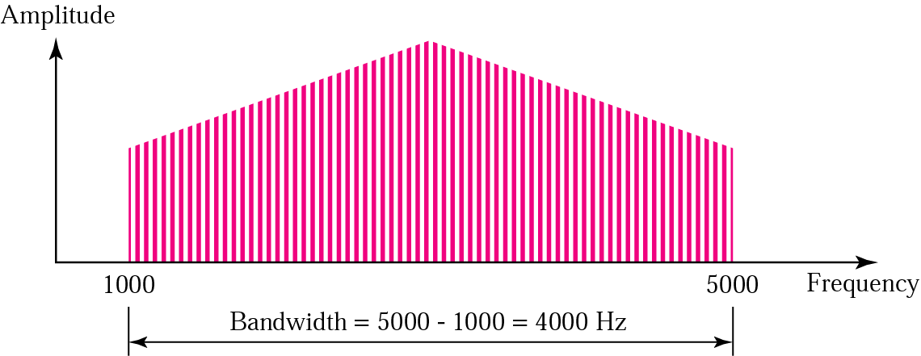
Analog and digital
Bandwidth
频谱：信号所包含的所有频率分量的集合，并且通过频域图表示。
带宽：信号频谱的宽度，即信号所包含的频率分量的范围。
频谱指的是带宽内的元素！

Slide 12
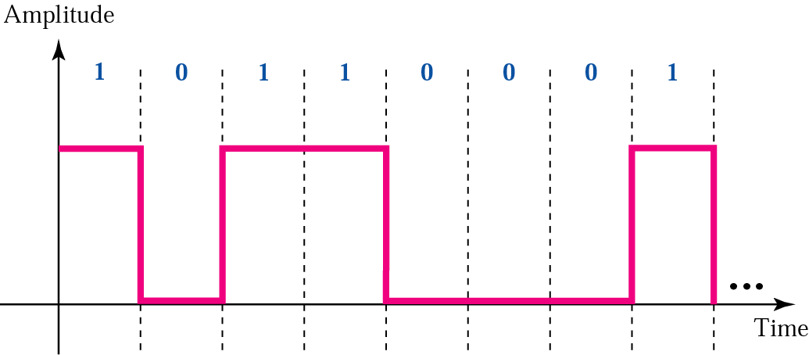
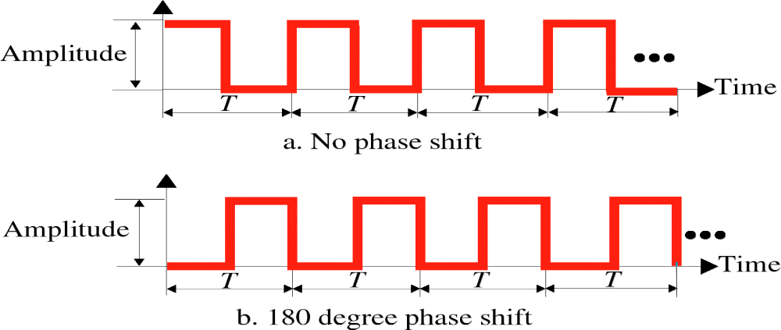
Analog and digital
Digital Signal
Amplitude, Period, and Phase for a Digital Signal

Slide 13
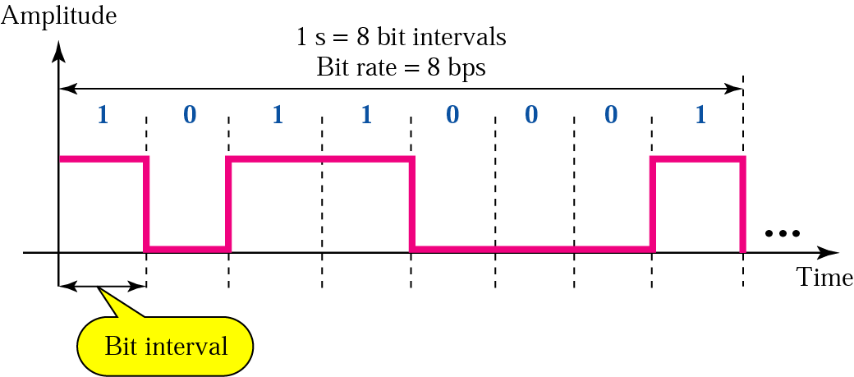
Analog and digital
Bit Rate and Bit Interval
比特间隔：发送一比特所需要的时间。
比特率：一秒钟内的比特间隔数，常用bps做单位。

Slide 14
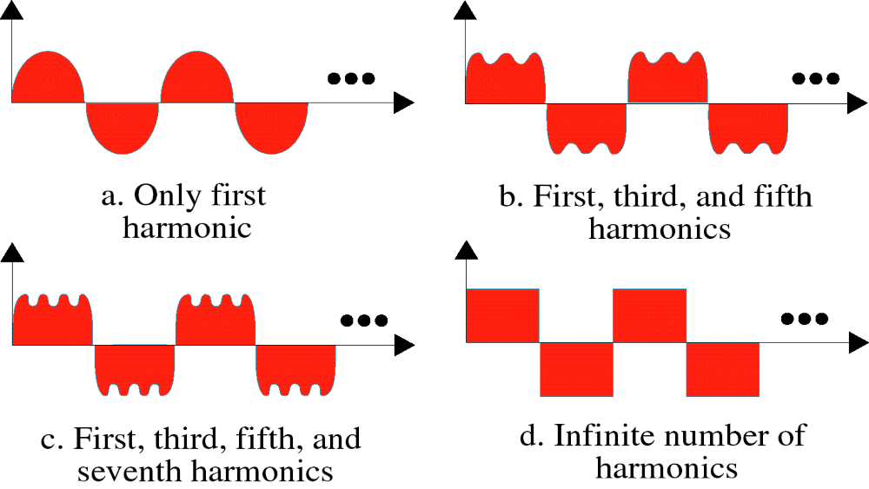
Analog and digital
Digital Signal as a Composite Analog Signal
数字信号可以被分解为无穷多个不同的谐波！这意味着我们在传输介质上发送数字信号时，其实是在发送无穷多的简单信号（谐波）。

Slide 15
Analog and digital
Digital Signal as a Composite Analog Signal
为了接收到数字信号的精确副本，所有频率的分量都必须通过介质传输；如果部分分量没有通过介质传输过来，就会导致接收端信号的变形。
Bandwidth Requirement
Bit Rate | Harmonic 1 | Harmonics 1, 3 | Harmonics 1, 3, 5 | Harmonics 1, 3, 5, 7
1 Kbps | 500 Hz | 2 KHz | 4.5 KHz | 8 KHz
10 Kbps | 5 KHz | 20 KHz | 45 KHz | 80 KHz
100 Kbps | 50 KHz | 200 KHz | 450 KHz | 800 KHz

Slide 16
Chapter 2 Signals
Analog and digital
Periodic and non-periodic Signals
Frequency Spectrum of Periodic Signals
Frequency Spectrum of a non-periodic Signal
Signal Transmission Through a Frequency band-limited Channel
1

Slide 17
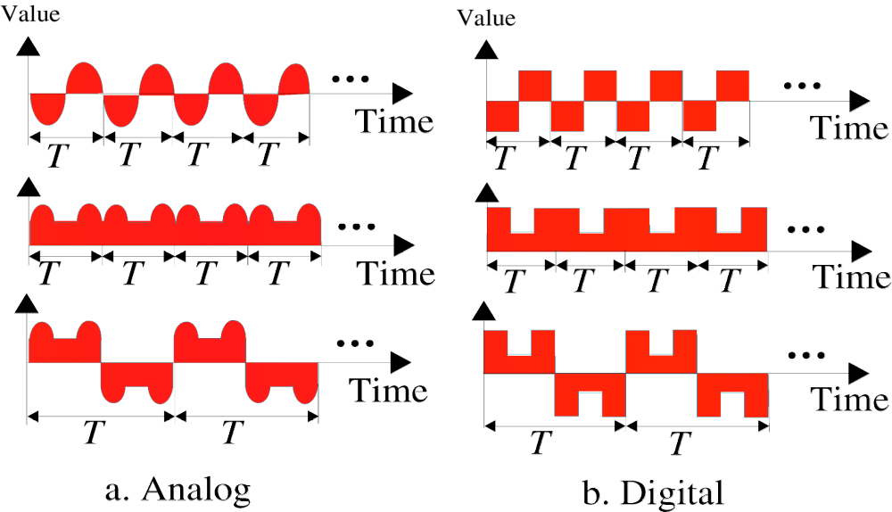
Periodic and non-periodic Signals
Periodic Signals
周期性信号：一个信号能在一段可测量的时间内完成一种模式，并且在随后的周期内不断重复这种模式。
周期：完成一次循环所需要的时间。

Slide 18
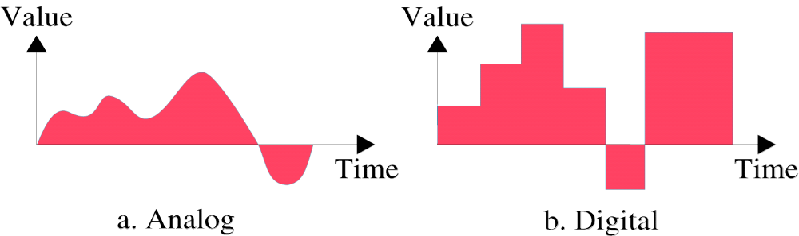
Periodic and non-periodic Signals
non-periodic Signals
非周期性信号：在随时间不断变化过程中不会出现任何固定的模式和循环。

Slide 19
Chapter 2 Signals
Analog and digital
Periodic and non-periodic Signals
Frequency Spectrum of Periodic Signals
Frequency Spectrum of a non-periodic Signal
Signal Transmission Through a Frequency band-limited Channel
1

Slide 20

Frequency Spectrum of Periodic Signals
Fourier Series -- 付立叶级数
* 一个任意的周期信号可用此表示为无穷多个谐波之和
● 正、余弦表示
若：s(t)=s(t±T) T为周期且在一个周期内连续或只有有限个第一类间断点。
（2-1）
被称之为： sine-cosine respresentation

Slide 21
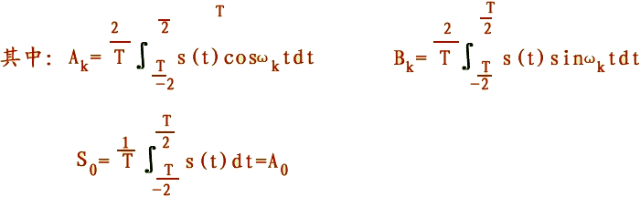
Frequency Spectrum of Periodic Signals
Fourier Series -- 付立叶级数
称：A0为直流分量 Ak、Bk为余、正弦分量的幅值(正弦波是最单纯的波不能再分解)。且ω1=2πf1 f1 =1/T
f1 为fundamental frequency – 基波频率

Slide 22
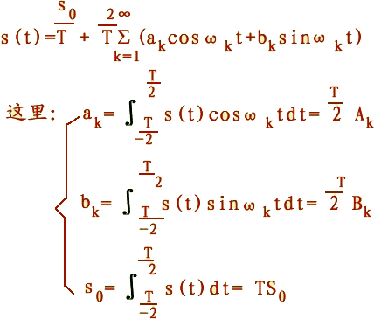
Frequency Spectrum of Periodic Signals
Fourier Series -- 付立叶级数
数学的方便表示：mathematics representation
（2-2）

Slide 23
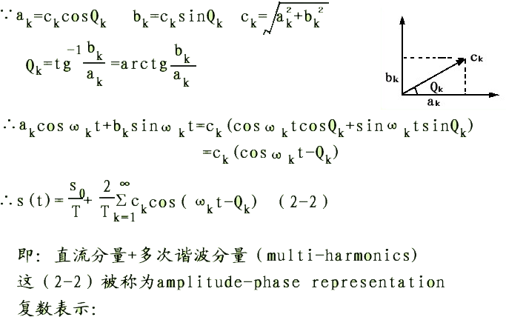
Frequency Spectrum of Periodic Signals
Fourier Series -- 付立叶级数
幅、相表示 amplitude-phase representation
实施 Triangular transform：

Slide 24
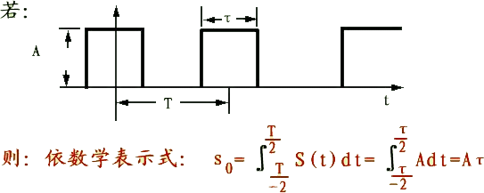
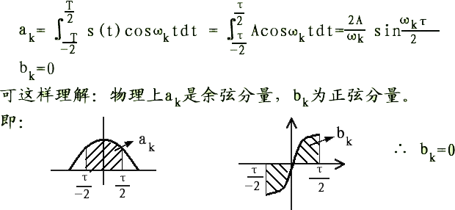
Frequency Spectrum of Periodic Signals
Frequency Spectrum of a periodic pulse signals
-- 周期性脉冲信号的频谱

Slide 25
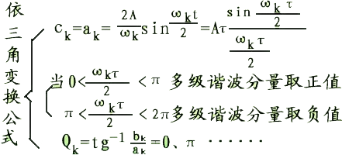
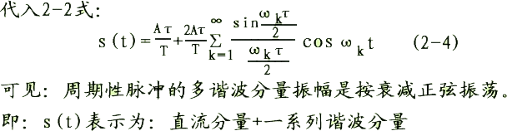
Frequency Spectrum of Periodic Signals
Frequency Spectrum of a periodic pulse signals
-- 周期性脉冲信号的频谱

Slide 26
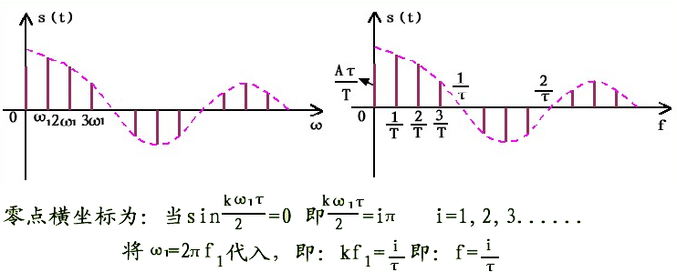

Frequency Spectrum of Periodic Signals
Frequency Spectrum of a periodic pulse signals
-- 周期性脉冲信号的频谱

Slide 27
Chapter 2 Signals
Analog and digital
Periodic and non-periodic Signals
Frequency Spectrum of Periodic Signals
Frequency Spectrum of a non-periodic Signal
Signal Transmission Through a Frequency band-limited Channel
1

Slide 28

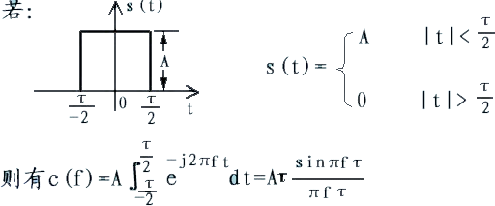
Frequency Spectrum of a non-periodic Signal
Fourier Integration (付立叶积分)
Frequency spectrum of a single pulse

Slide 29
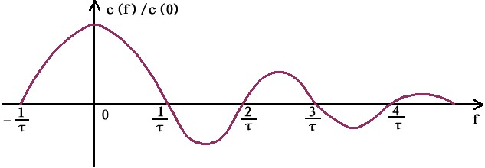
Frequency Spectrum of a non-periodic Signal
Frequency spectrum of a single pulse

Slide 30
Chapter 2 Signals
Analog and digital
Periodic and non-periodic Signals
Frequency Spectrum of Periodic Signals
Frequency Spectrum of a non-periodic Signal
Signal Transmission Through a Frequency band-limited Channel
1

Slide 31
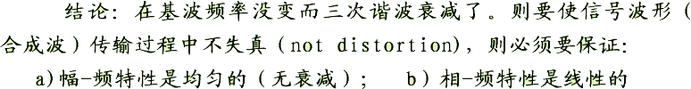
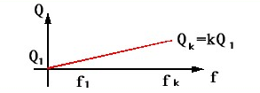
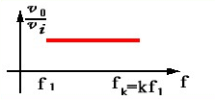
Signal Transmission
Charateristics of Signal Channel

Slide 32
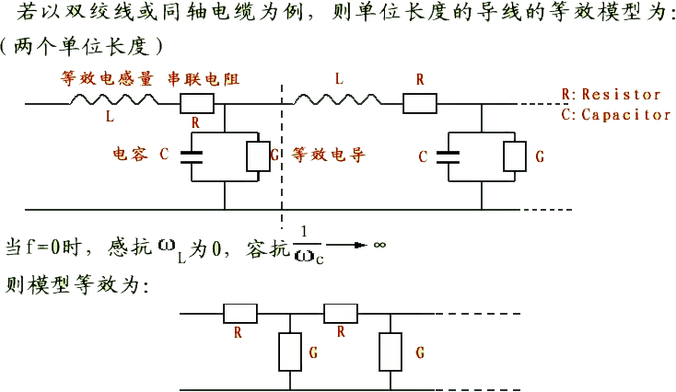
Signal Transmission
Characteristics of a practical channel

Slide 33
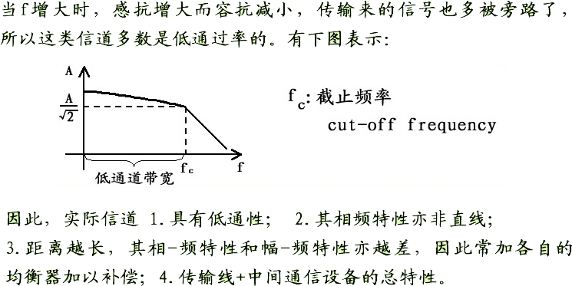
Signal Transmission
Characteristics of a practical channel

Slide 34
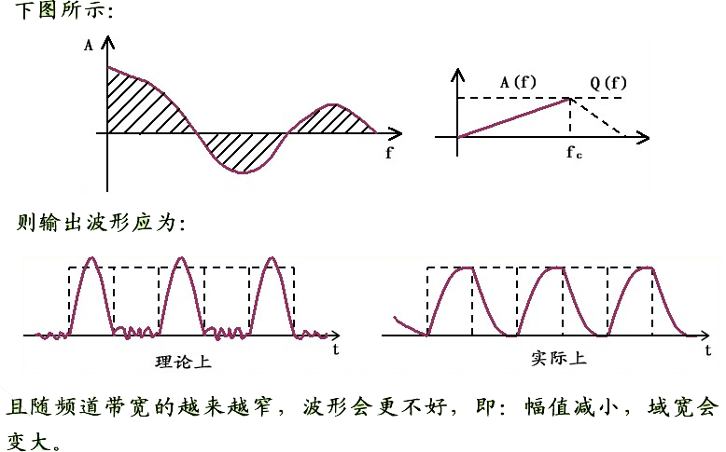
Signal Transmission
Output waveform of a digit Signal

Slide 35

Signal Transmission
Relation between transmission line bandwidth and signal transmitting rate
Data rate of a binary-coded signal transmission through a telephone line

Slide 36
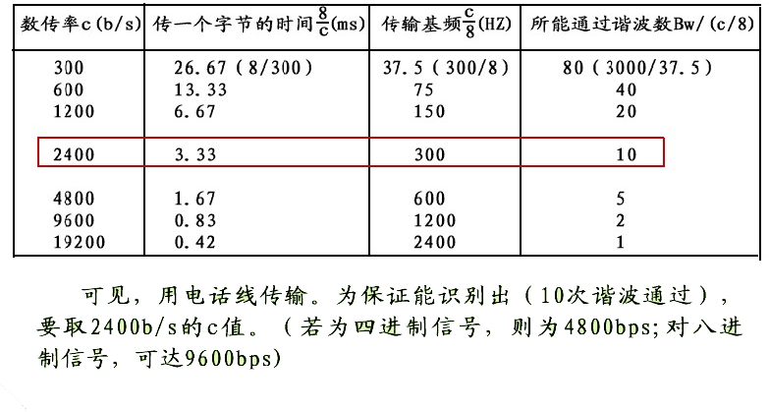
Signal Transmission
Data rate of a binary-coded signal transmission through a telephone line

